Slide 1
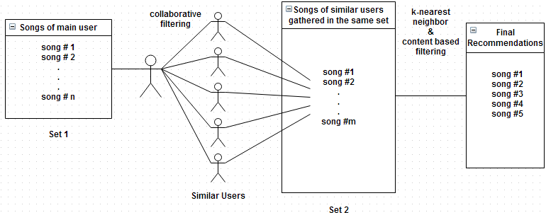
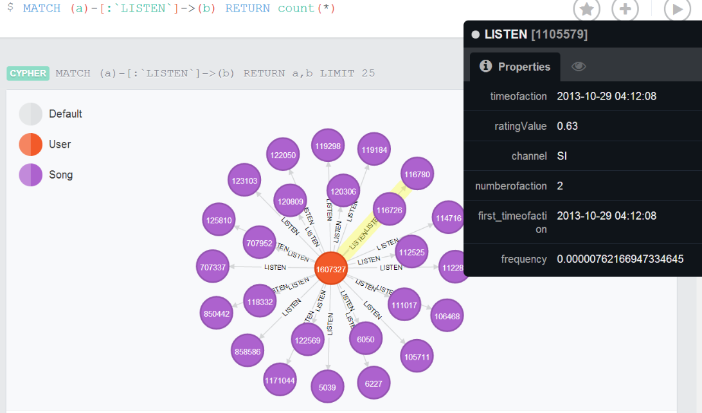
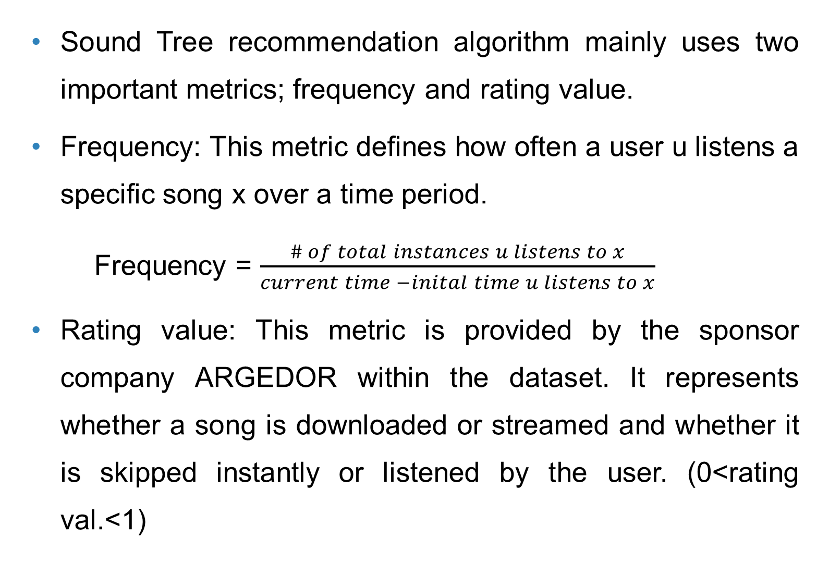
Music Recommendation System: “Sound Tree”
Dcengo Unchained: Sıla KAYA, BSc.; Duygu KABAKCI, BSc.; Işınsu KATIRCIOĞLU, BSc. and Koray KOCAKAYA BSc.
Assistant : Dilek Önal
Supervisors: Prof. Dr. İsmail Hakkı Toroslu, Prof. Dr. Veysi İşler
Sponsor Company: ARGEDOR
Abstract
Recommendation Method
Results
Recommendation systems are software tools or knowledge discovery techniques that provide suggestions for items to a user. Sound Tree is a music recommendation system which can be integrated to an external web application and deployed as a web service. It uses people-to-people correlation based on user’s past behavior such as previously listened, downloaded songs. Sound Tree generates the recommended songs from an immense graph database of interconnected song, user, album and performer nodes.
Sound Tree recommendation algorithm mainly uses two important metrics; frequency and rating value.
Frequency: This metric defines how often a user u listens a specific song x over a time period.
Frequency = $\frac{\# of total instances u listens to x}{current time −inital time u listens to x}$
Rating value: This metric is provided by the sponsor company ARGEDOR within the dataset. It represents whether a song is downloaded or streamed and whether it is skipped instantly or listened by the user. (0<rating val.<1)
Objectives
Sound Tree evaluations are completed with databases of 20 days, 30 days and 2 months user logs.
The precision result of each user in the test and training dataset is averaged in order to find an overall precision.
Recommend songs that a user is likely to be interested in
Learn more about users’ preferences and constraints
Help users become more aware of their preferences
Enhance the usage of main music streaming application
Cold Start Problem: Give recommendations to users for whom the system has very little information concerning the listening habits (i.e. newbie users)
Figure 2: Recommendation method
Collaborative filtering (Main paradigm): Sound Tree finds five similar users to the main user according to common listened songs.
Weka k-nearest neighbor: This algorithm finds similarity among Set 1 and Set 2 songs in Figure 2. To be considered as similar, songs should have close frequency and rating values. The songs in Set 2 that are found more similar to the songs in Set 1 are chosen as candidates for final recommendations.
Content based filtering (Helper paradigm): After collaborative filtering and k-nearest neighbor steps, songs with common albums, performers and genres are considered as higher priority recommendations.
Cold Start: Giving recommendations with content based approach for newbie users and users who do not match with other users.
Conclusion
Collaborative filtering is the best method for recommender systems with excessive amount of users and user logs
Graph databases speed up the retrieval of song nodes and user nodes when there are nearly 6 million user logs.
When dataset size is increased, Sound Tree produces more accurate recommendations.
Cold Start: Sound Tree gives recommendations even if there is no significant information about the user.
Data Design and Classification
Dataset, provided by the sponsor company ARGEDOR contains song, album and performer mappings as well as detailed user logs of four months. User logs include the user ids, the song ids and the time of listening.
Dataset is embedded into Neo4j graph database (Figure 1). Neo4j allows us to reach a new similar user with new preferences from an existing known user through common songs.
Experimental Evaluations
User logs of 20, 30, 60 days are processed in Sound Tree to test with different sized databases.
Green: 20 days Blue: 30 days Red: 2 months
Evaluation metric: Precision is calculated for each user based on recommendations from training dataset.
Precision: $\frac{\# of successful recommendations}{\# of total recommendations}$
Denominator of precision is 5 because Sound Tree recommends 5 songs for every user.
We would like to thank our advisors Prof. Dr. İsmail Hakkı Toroslu, Prof. Dr. Veysi İşler, Dilek Önal and the sponsor company ARGEDOR for their detailed comments and suggestions.
 | Number of users | Number of songs | Average number of songs per user
Training Dataset (80 % of the dataset) | 158542 176650 251378 | 1240034 1240034 1240034 | 22.83 30.68 55.41
Test Dataset (20 % of the dataset) | 71242 82173 112967 | 1240034 1240034 1240034 | 14.12 18.78 26.56
References
[1] Herlocker, J., Konstan, J. A., & Riedl, J. (2002). An Empirical Analysis of Design Choices in Neighborhood-Based Collaborative Filtering Algorithms. Information Retrieval, 5(4), 287-310. doi:10.1023/A:1020443909834
[2] Sarwar, B. M., Karypis, G., Konstan, J., & Riedl, J. (2002). Recommender Systems for Large-scale E-Commerce: Scalable Neighborhood Formation Using Clustering. Paper presented at the 5th International Conference on Computer and Information Technology (ICCIT), 27-28 December 2002. Retrieved from http://grouplens.org/papers/pdf/sarwar_cluster.pdf
Figure 1: Neo4j graph database
Reaching many similar users requires classification of them so that only the most related users and their songs are picked for the recommendation.
Weka machine learning library provides k-nearest neighbor classifier for this purpose.

