Slide 1
INTRODUCTION
Group : Pix’r’Us
Project : PhotoLab
Company : Milsoft
Supervisor : Murat YUKSELEN
Website : http://senior.ceng.metu.edu.tr/2008/pixrus/

Slide 2
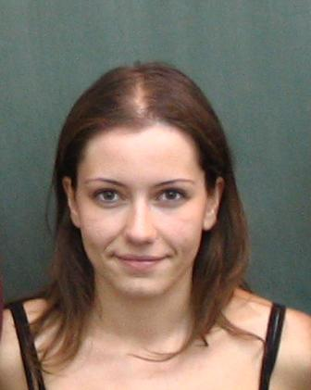
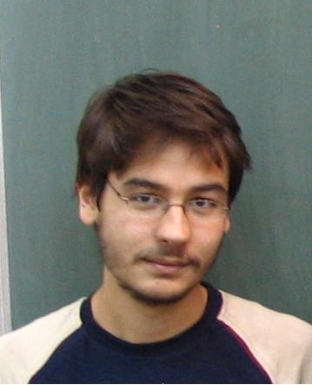
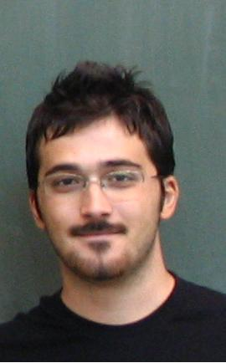
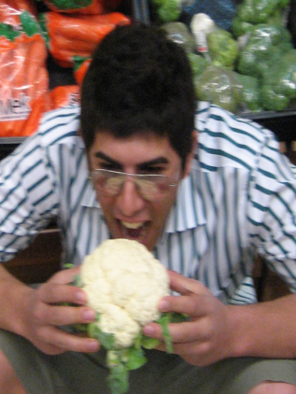
INTRODUCTION
Who are we?
Ebru Aydin: Developer Team The BOSS Time Keeper | Ozan Kabak: Developer Team Initiator Summarizer
Ender Erel: Developer Team Devil’s Advocate Gate Keeper | Berk Demir: Testing and Documentation Single Optimist & Recorder

Slide 3
INTRODUCTION
Outline
Introduction
Project Description - Photolab
What is Photogrammetry
PPS Overview
PPS Functionalities
Did’s and Will Do’s
Demo
Questions and Answers

Slide 4
Project Description
What is Photolab about?
Photolab is a Photogrammetry Software development project
which is focused on:
- Image Mosaicking
- DEM Generation
- Orthophoto Generation
supported by Milsoft.

Slide 5
Project Description
What is Photogrammetry?
Photogrammetry is the first remote sensing technology ever developed, in which geometric properties about objects are determined from photographic images. Historically, photogrammetry is as old as modern photography itself, and can be dated to mid-nineteenth century.

Slide 6
Project Description
Where Photogrammetry is used?
Topographic mapping, -Architecture, engineering, manufacturing, -Quality control -Geology -In movie post production, eg: Fight Club

Slide 7
Pix’r’us Photogrammetry Suite
PPS – Pix’r’us Photogrammetry Suite, is a Multiple-Document Interfaced photogrammetry tool with functionalities;
DEM Creation
Orthophoto Creation
Image Mosaicking

Slide 8
Pix’r’us Photogrammetry Suite
PPS is developed in C++
External libraries used;
OpenCV
GDAL
OpenGL
WX Widgets

Slide 9
Project Progress
So far we have;
Developed the interface
Commonly used functionalties,eg : save/load
Integrated all external libraries
Functionalities added;
Image Mosaicking – using homography
Image Mosaicking – using camera parametrs
Orthophoto Creation
Image editor

Slide 10
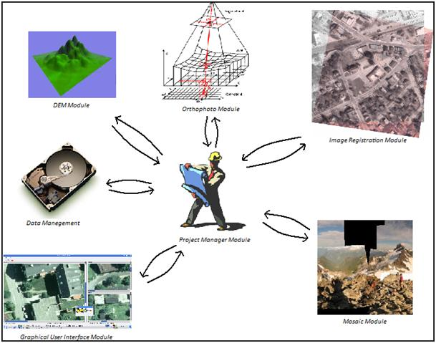
PPS Design Review

Slide 11
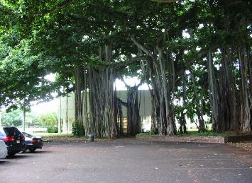
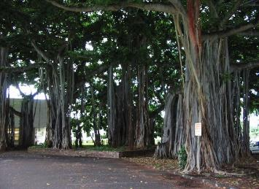
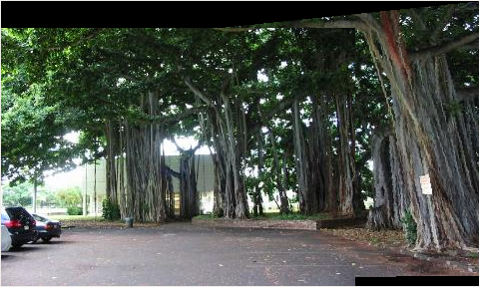
PPS Functionalities
Image Mosaicking
Combining two images by using common points between them.Example :
+
=

Slide 12
PPS Functionalities
Image Mosaicking
How it works
- Image registration
a. Find Corners – Harris Corner Detection
b. Calculate Putative Matches
c. Calculate Homography Matrix
- Combine them! – with interpolation methods

Slide 13
PPS Functionalities
DEM:
Digital Elevation Model (DEM) is digital representation of ground surface topography or terrain. DEMs are the first step to rectification of aerial photos. PPS will generate DEMs by using multiple images.

Slide 14
PPS Functionalities
DEM:
How it works? { under bi yerlerde }

Slide 15
PPS Functionalities
Orthophoto:
An orthophoto or orthophotograph is an aerial photograph that has been geometrically corrected (“orthorectified”) such that the scale of the photograph is uniform, meaning that the photo can be considered equivalent to a map.
IMAGE:

Slide 16
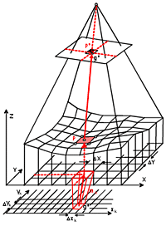
PPS Functionalities
Orthophoto:
How it works?
- Using camera calibration parameters,
calculate world coordinates of every point
of the image,
- With this information construct the
geometrically corrected image

Slide 17
PPS Functionalities
Image Editor:
A simple Image Editor, which can adjust attributes such as;
- Brightness
- Contrast
also can do;
- Scale
- Rotation
simple image operations such as;
- Laplace, sobel, smoothing filters, histogram equalization etc.

Slide 18
Did’s and Will Do’s
Things that have been done | Things to be done
Mosaicking Orthophoto Creation Image to Earth Registration Image Editor - partial GUI -Save&Load -Testing - parallel | DEM Creation Image Editor Functions Documentation Testing - parallel

Slide 19
THE END!
For more info and reports;
senior.ceng.metu.edu.tr/2008/pixrus/
QUESTIONS PLEASE

