Slide 1
The Hardware Security Module

Slide 2
Agenda
MAHOhard members
To give background
Project details
Design and implementation

Slide 3
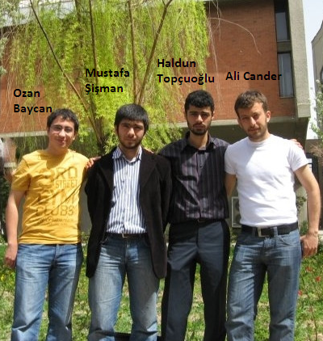
Who are we?

Slide 4
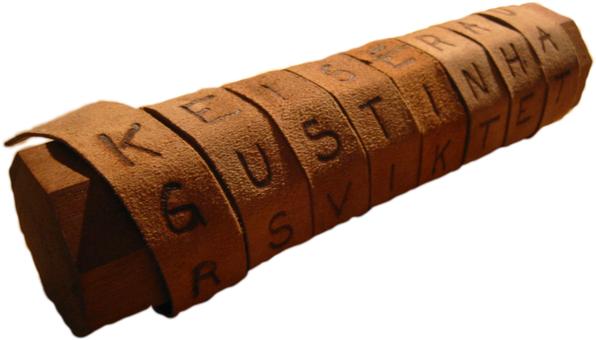
Cryptography - Short History
Classical Cryptography
Greece: transposition ciphers (change order of
characters) with the scytale.

Slide 5
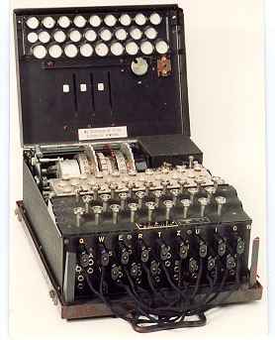
Cryptography – Short Story 2
Enigma Cipher Machine
Polyalphabetic substitution (continually changing substitution alphabet)

Slide 6
Cryptography and HSMs
What have we learned?
Cryptography uses SECRET keys
So we need something to protect these keys
A Hardware Security Module

Slide 7
Why HSM?
SECURITY
SECURITY
SECURITY PERFORMANCE
SECURITY
SECURITY
SECURITY PERFORMANCE
SECURITY
PERFORMANCE

Slide 8
What is HSM?
HSM
Hardware Security Module
Definition
Black box combination of hardware and software
Attached a PC or server
Provides cryptographic functions
Physical/logical tamper protection (security)
(Increased performance)

Slide 9
General Overview (Cont’d)
HSM Executive - main picture of HSM

Slide 10
General Overview (Cont’d)
HSM Executive - main picture of HSM
External communication - for communication with server

Slide 11
General Overview (Cont’d)
HSM Executive - main picture of HSM
External communication - for communication with server
FPGA management - for cryptographic functions, time scheduling and data management

Slide 12
FPGA Management Component
Microcontroller

Slide 13
FPGA Management Component
Microcontroller
Encryption

Slide 14
FPGA Management Component
Microcontroller
Encryption
Decryption

Slide 15
FPGA Management Component
Microcontroller
Encryption
Decryption
Hashing

Slide 16
FPGA Management Component
Microcontroller
Encryption
Decryption
Hashing
Random Key Generator

Slide 17
FPGA Management Component
Microcontroller
Encryption
Decryption
Hashing
Random Key Generator
Digital Signature

Slide 18
General Overview

Slide 19
What hardware will be used?
Altium Nanoboard 3000

Slide 20
What Languages?
VHDL
Embedded C/C++

