Slide 1
CENG 492 – COMPUTER ENGINEERING DESIGN 2
“VIRTUAL TURKEY” MMORPG PROJECT
Group MECAC
Ümit Çavuş Büyükşahin
Mert Değirmenci
Çınar Kılcıoğlu
Academic Advisors
Veysi İşler
Ümit Ruşen Aktaş
Şponsor
MODSIMMER
May 16, 2011
Notes:
Hi, my name is mert degirmenci. And in the following ten minutes I will be presenting you our graduation project. Virtual Turkey. Before we go into details of the project. I want to introduce you my team mates. Cinar kilcioglu and umit buyuksahin and me constitutes MECAC project group. This project is sponpored by Modeling and Simulation Center. And our group advisor is Umit Rusen Aktas. Lets have a look at outline of today.

Slide 2
Outline
Project Definition
Problem Definition
The Goal of the Project
System Features
Demo
Notes:
Outline

Slide 3
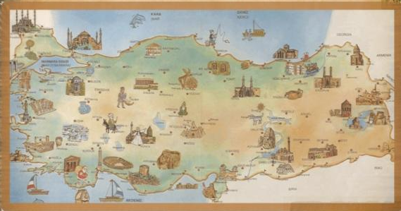
Project Definition
What is “Virtual Turkey”?
MMORPG ( Massively Multiplayer Online Role-Playing Game)
Open source
Bolster touristic interest in Turkey
Notes:
The name of the project is virtual Turkey. It is planned to be a desktop game. So there wont be a browser support for it. Virtual Turkey is a masssively multiplayer online role playing game. The sources of the project will be released under GPL licence so that everybody will have the chance to contribute to it. The main aim of such project is to bolster touristic interest in Turkey. So that culture enthusiast will have the chance to get to know about touristic sight seeing places in Turkey before visiting. This would hopefully increase the culture tourisim in Turkey. Here is a sample map from the game. As you see the scenario takes place in Turkey. As you see, in the persistent world, there are numbers of quests that causal MMOG players can follow aligned with the game story. But virtual Turkey is not only open source MMOG project.

Slide 4
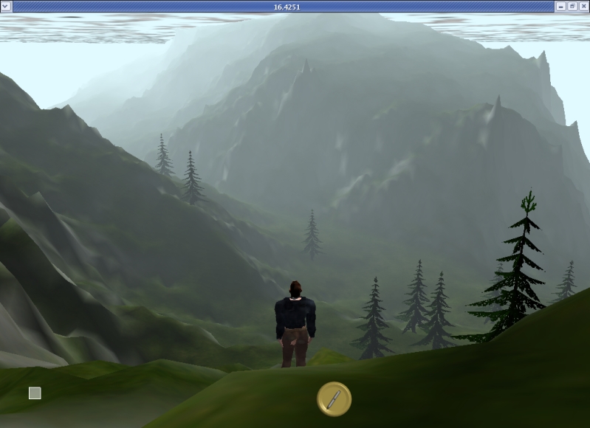
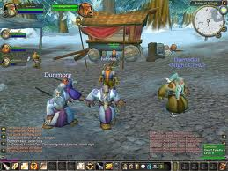
Project Definition
Market Research
WorldForge
Around thousand players online
World of Warcraft
10 million subscribers
1 million concurrent players
Notes:
There has been quite few successful open source MMOG projects. WorldForge is the most successful one and in fact the only one we could found online. Even that one can not be compared to leading MMOGS such as World of Warcraft which has ten million subscribers. The reason for this is that MMOG deployment is costly. Server and the bandwidth requirements are quite huge for an open source project to handle. Even if you can handle the development though its quite challenging as such project requires coordination, the cost of maintaining an open source project is unbearable. So there are number of problems with Virtual Turkey. When we have first considered this as our project, we were well aware of this problems but committed to the purpose of doing something good for touristic attraction to Turkey.

Slide 5
Project Definition
What is “Virtual Turkey”?
Notes:
Short video of the game

Slide 6
Problem Definition
Lack of
Maintainability & Portability
Notes:
Open-source project requires maintainability, portability and scalability.

Slide 7
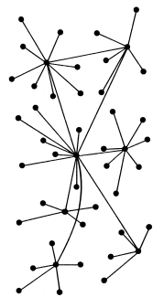
Problem Definition
Lack of
Scalability
Notes:
Once we started the project, it could be played by at most 4 players concurrently. It contradicts with the term “Massively Multiplayer”

Slide 8
The Goal of the Project
To make the game “Massively Multiplayer” with Network Optimization
Bandwidth Management
Seamless Gameplay
Congestion Control
Satisfying maintainability and portability

Slide 9
System Features
Main features of Virtual Turkey:
Intelligent data streaming
Dynamic bandwidth calculation
Advanced area of interest computation

Slide 10
Intelligent Data Streaming
Receivers ( 1-N )
To handle cases where there is no bandwidth to send all messages.
Hold and sort method. Each client is the sender at one row and receiver at N columns.
We call this approach as Event Matrix.
Senders ( 1-N )

Slide 11
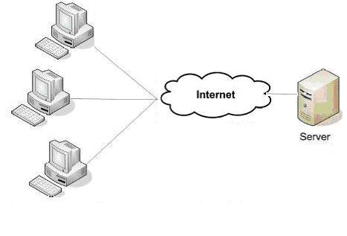
Dynamic Bandwidth Computation
Where do we know how many messages could be sent ?
We need to analyze connections to control congestion.
High level TCP like bandwidth computation.

Slide 12
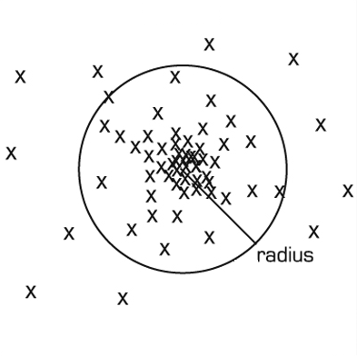
Prioritization of Messages
Which message is urgent ?
Primitive approach :
Distance between clients

Slide 13
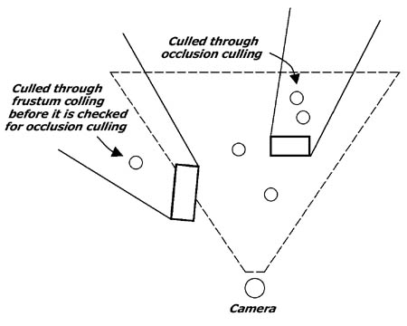
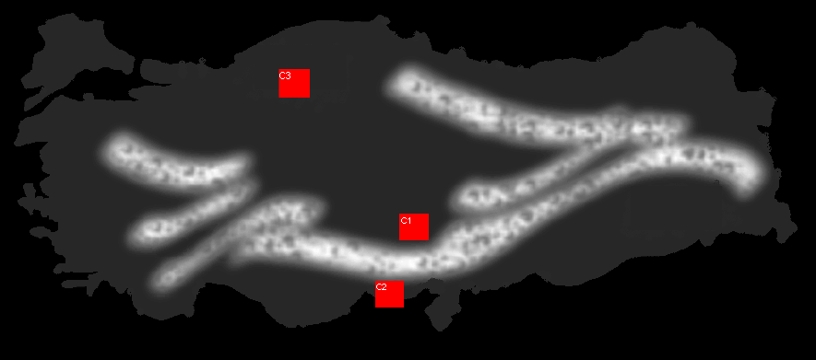
Area of Interest Calculation
Consider occlusions in area of interest computation.
Score urgency of the message according to area of interest.

Slide 14
Demo

Slide 15
Thank You!
Questions?
Notes:
So that’s all I have wanted to present about Virtual Turkey. Thank you for listening my presentation.
If you have any questions I and my team mates can answer them all.

