Slide 1
Greenhouse Monitoring using Wireless Sensor Networks (WSN) Sponsored by INNOVA
Rongo Rongo

Slide 2
Outline
Team Members
Problem Definition
Purpose of the Project
Market Research
Project
Hardware
How it works
Target
What we have done so far
Future Work
Conclusion

Slide 3
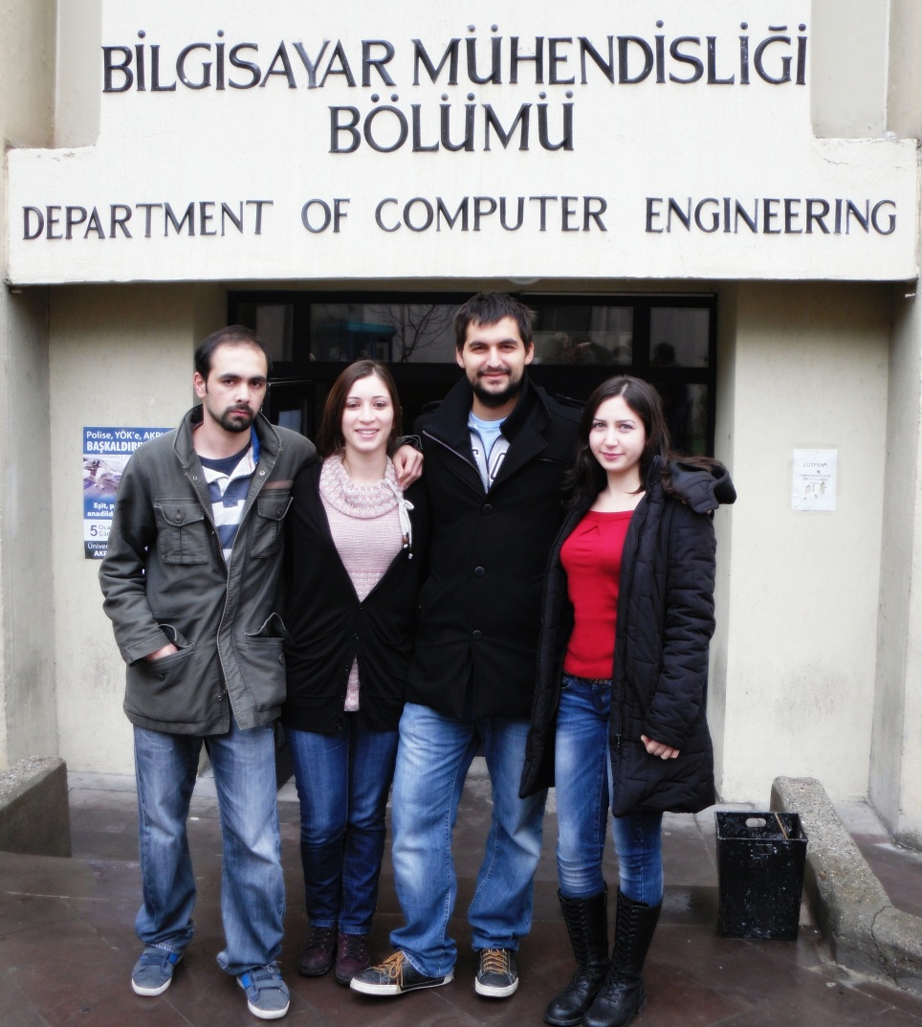
Team Members
F. Aybike Avşaroğlu
Esra Gariboğlu
Osman Kaya
Önder Kalacı

Slide 4
Outline
Team Members
Problem Definition
Purpose of the Project
Market Research
Project
Hardware
How it works
Target
What we have done so far
Future Work
Conclusion

Slide 5
Problem Definition
Monitoring environmental variables for productivity, growth and quality of a plant
Tracing down the local climate parameters in the different parts of greenhouses
Using cabling for monitoring is expensive and vulnerable
A sensor network is composed of a large number of sensor nodes with sensing, processing and communication capabilities.

Slide 6
Outline
Team Members
Problem Definition
Purpose of the Project
Market Research
Project
Hardware
How it works
Target
What we have done so far
Future Work
Conclusion

Slide 7
Purposes
Periodically measure the temperature, light and humidity levels inside the greenhouse
Notify the greenhouse manager in case of a critical change in one of the measurements
Major goal is to increase the productivity and quality of the plants in a greenhouse without observing it whole day.

Slide 8
Outline
Team Members
Problem Definition
Purpose of the Project
Market Research
Project
Hardware
How it works
Target
What we have done so far
Future Work
Conclusion

Slide 9
Market Research
Similar applications exist in world market.
In Turkey it has not yet developed entirely and it is in use only in a few cities.

Slide 10
Outline
Team Members
Problem Definition
Purpose of the Project
Market Research
Project
Hardware
How it works
Target
What we have done so far
Future Work
Conclusion

Slide 11
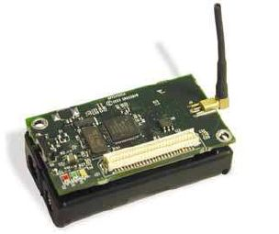
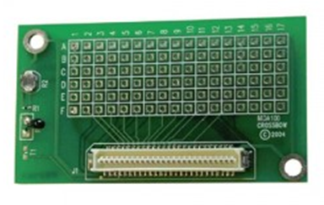
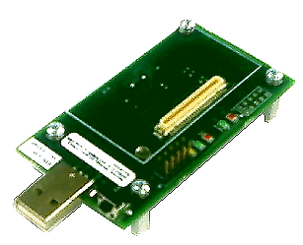
Project – Hardware
Processor/Radio Board
Sensor Board
Gateway/Programming Interface

Slide 12
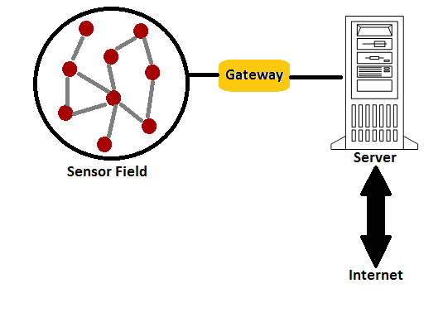
Project – How it works
Nodes in the sensor field measure periodically the temperature, light and humidity.
They send the measurements to gateway and then the base station via wireless network.
The base station will insert the data into a database.
The web application will
provide a user interface
to analyse the condition
in greenhouse.

Slide 13
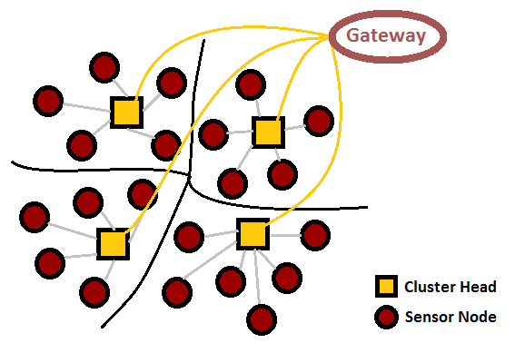
Project – How it works

Slide 14
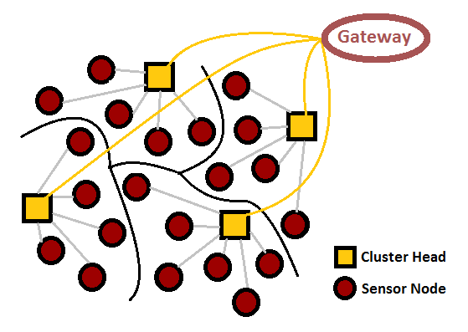
Project – How it works

Slide 15
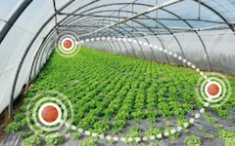
Project – Target Market
Agriculture, Greenhouses
Greenhouses can be monitored remotely without observing it whole day individually.

Slide 16
Outline
Team Members
Problem Definition
Purpose of the Project
Market Research
Project
Hardware
How it works
Target
What we have done so far
Future Work
Conclusion

Slide 17
What we have done
Project Proposal
Market Research
Acquiring some of the Sensor Nodes and Gateway for the prototype
Initial Design Report

Slide 18
Outline
Team Members
Problem Definition
Purpose of the Project
Market Research
Project
Hardware
How it works
Target
What we have done so far
Future Work
Conclusion

Slide 19
Future Work
Detailed Design report
Prototype Implementation
Network Component
Gateway Component
Web Application Component

Slide 20
Outline
Team Members
Problem Definition
Purpose of the Project
Market Research
Project
Hardware
How it works
Target
What we have done so far
Future Work
Conclusion

Slide 21
QUESTIONS?

