Slide 1
Mobile Content Generator
A.T.O.M.
e-Nocta

Slide 2

Team Members
Ayşenur
Durgut
Talha
Koruk
Okhan
Durmaz
Merve
Mıtık

Slide 3



Problem Definition
Compatibility
Simplicity
Privacy

Slide 4
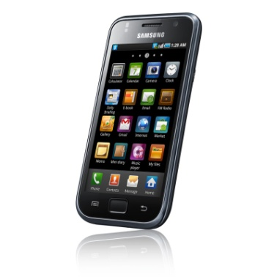

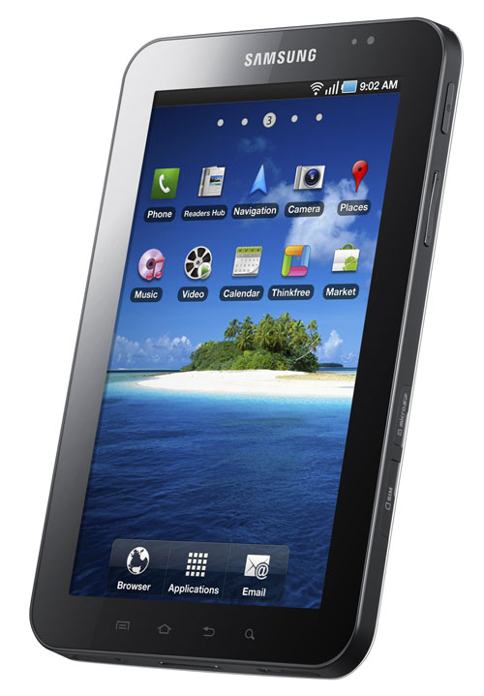

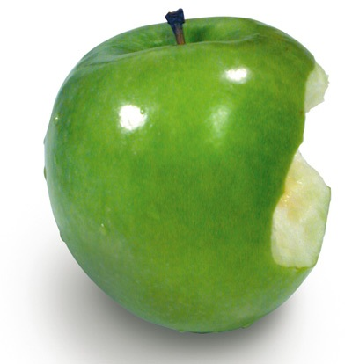
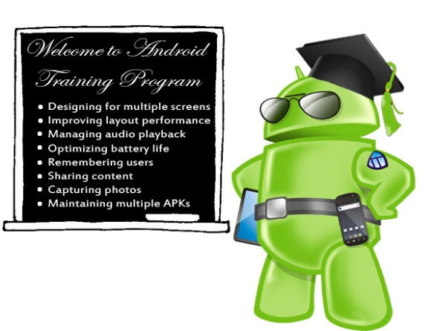
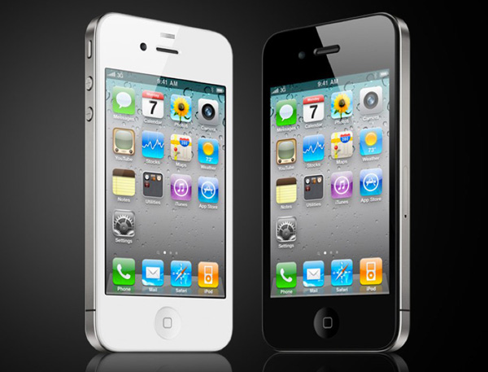
COMPATIBILITY

Slide 5


DO NOT WORRY
BE HAPPY

Slide 6



PRIVACY

Slide 7

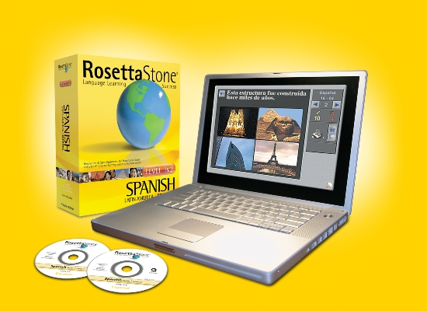

MARKET OF E-LEARNING
Incompatible
Uneasy
Public

Slide 8
Motivation
Importance of e-learning
Future technology
Software for everyone

Slide 9
Our Approach
HTML5
C#
ASP.NET
MS SQL
Visual Studio
Kaltura Api
Kaltura.com

Slide 10
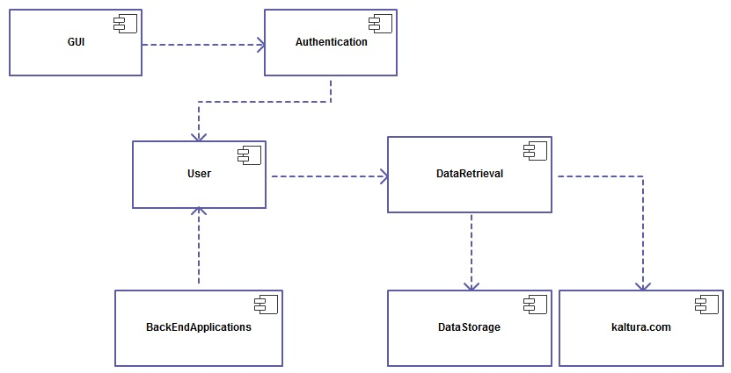
Components

Slide 11
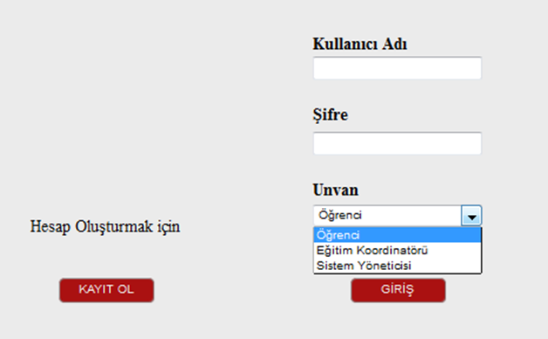
User Interfaces

Slide 12
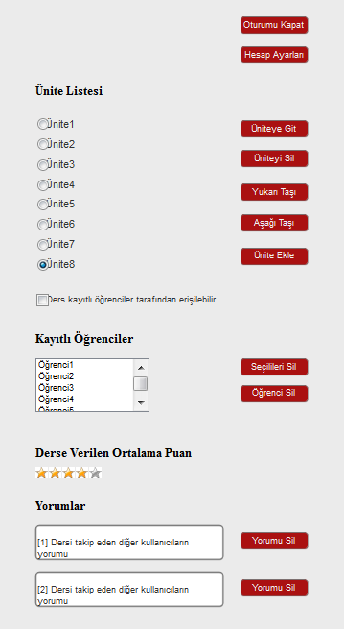
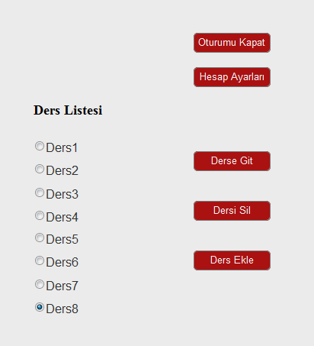
Instructor

Slide 13
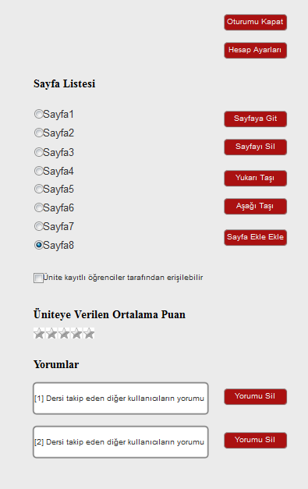
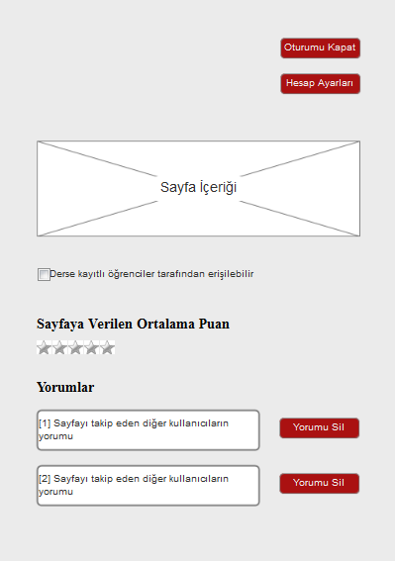
Instructor

Slide 14
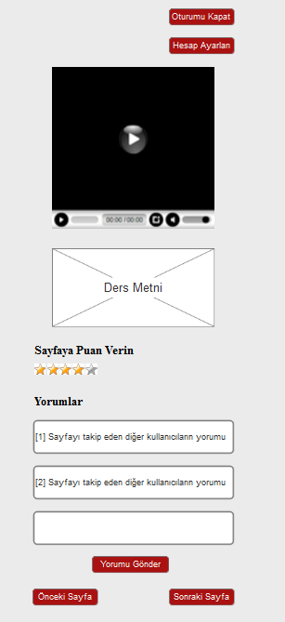
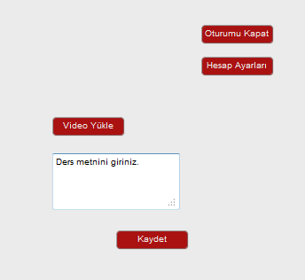
Video-Text

Slide 15
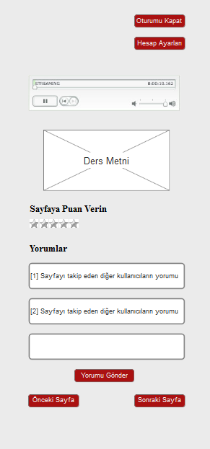
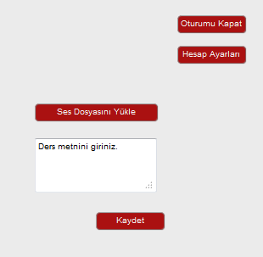
Audio-Text

Slide 16
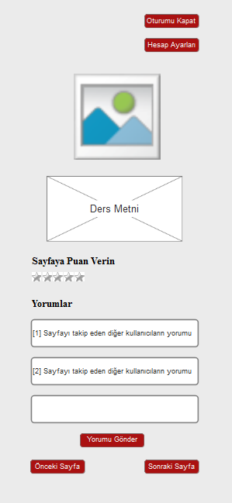
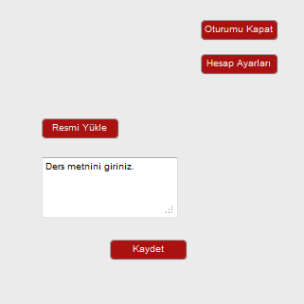
Image-Text

Slide 17
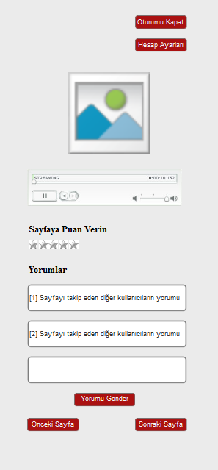
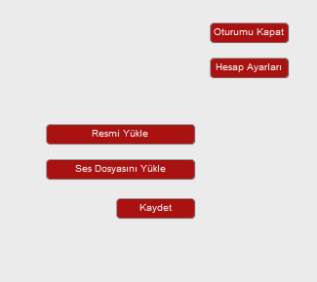
Image-Audio

Slide 18
So far…
Project Reports
Field research
User Interfaces
Database Design
Started using Kaltura & Asp.Net

Slide 19
Future Work
Video processing with Kaltura
Implementation of Database
Implementation of Templates
Testing
Extra Features

Slide 20
References
D. Stockley. (2011, Jan. 19). What is E-Learning? [Online]. Available: http://derekstockley.com.au/elearning-definition.html
http://www.w3schools.com
http://corp.kaltura.com/

Slide 21


Slide 22


