Slide 1

D-BUG
Turkish Sign Language Recognition Using Microsoft Kinect Sponsored by INNOVA

Slide 2
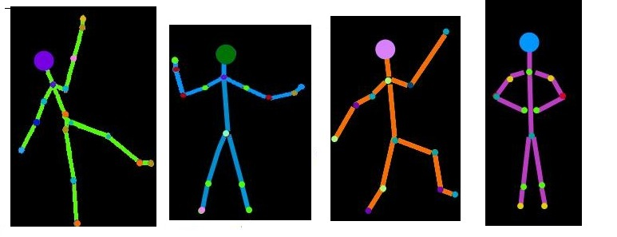
Group Members
Duygu
Aralıoğlu
Bedia
Acar
Ulaş
Şahin
Gülnur Neval
Erdem

Slide 3
Outline
Problem & Solution
Project Details
Work Done So Far
Project Demo Video
Future Work
References

Slide 4
Outline
Problem & Solution
Project Details
Work Done So Far
Project Demo Video
Future Work
References

Slide 5
Problem & Solution
The main problem is communication problem between speech-impaired people and the others.
Being unable to express himself/herself can be frustrating.

Slide 6
Problem & Solution
Our Solution:
Our goal: To help alleviate the frustration that speech-impaired people face by using assistive technology.
Final Product: Gets the sign language gestures and give the meaning of them in text format.

Slide 7
Outline
Problem & Solution
Project Details
Work Done So Far
Project Demo Video
Future Work
References

Slide 8
Project Details
Components of the System
Environmental Assumptions
Libraries & Tools

Slide 9
Components of the System
InputHandler
InterfaceHandler
HMM
Recognizer

Slide 10
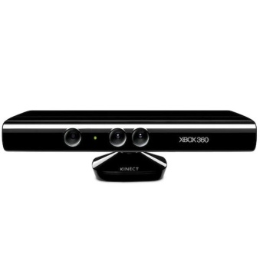
Components of the System
Joint
positions
InputHandler
Video stream
Matrix indices
Scaled hand positions
Video stream
Gesture name
Recognizer
InterfaceHandler
Observation
sequence
Probability
HMM
Figure 1: Interaction of the Components

Slide 11
Components of the System
InputHandler
  Repeatedly arranges Kinect input
  Calculates hand positions on the screen
  Creates SpaceZoningMatrix

Slide 12
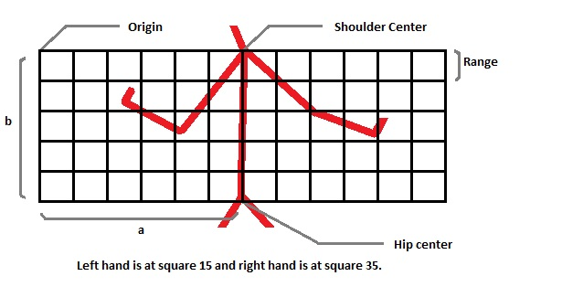
Components of the System
InputHandler
Figure 2: Space Zoning Matrix

Slide 13
Components of the System
InterfaceHandler
  Manages the user interface
  Moves hand cursors
  Changes interface modes

Slide 14
Components of the System
What is an HMM?
  HMM (Hidden Markov Model) is a probabilistic model created with a state set and an observation set. Model is based on the assumption that a visible observation sequence is triggered by hidden states of the model .

Slide 15
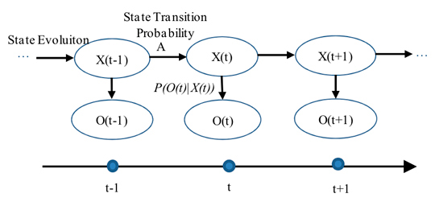
Components of the System
HMM
Figure 3: General Hidden Markov Model
Retrieved from http://www.mental.sk/temp/ai/csr.html

Slide 16
Components of the System
An HMM is defined with:
  Initial state distribution matrix
  State transition matrix
  Observation matrix

Slide 17
Components of the System
Three problems:
Problem 1: Given a model, and a sequence of observations O find the probability of observing O in this model.

Slide 18
Components of the System
Three problems:
Problem 2: Given a model and an observation sequence O, determine the optimal state sequences that results in given observation sequence in the given model.

Slide 19
Components of the System
Three problems:
Problem 3: Given an observation sequence O and the dimensions N and M, determine the model which maximizes the probability of observing O.

Slide 20
Components of the System
In TSL-Kinect
Use the solution to Problem 3 to train an HMM for each gesture.
Use the solution to Problem 1 to determine
the gesture is more likely to be “X” or “Y” or neither.

Slide 21
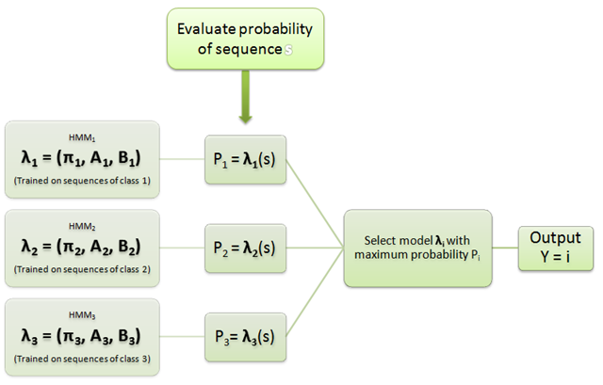
Components of the System
Figure 4: Working principle of HMMs
Retrieved from
http://lh5.ggpht.com

Slide 22
Components of the System
Recognizer
  Creates observation sequence for both hand
  Release sequence stacks

Slide 23
Environmental Assumptions
Set up Kinect properly
Stand 1.8 - 2.4 meters away from the sensor
No moving objects around!

Slide 24
Libraries & Tools
The Microsoft official SDK for Kinect
Microsoft Visual Studio 2010
NUI library
Coding4Fun Kinect Toolkit

Slide 25
Outline
Problem & Solution
Project Details
Work Done So Far
Project Demo Video
Future Work
References

Slide 26
Work Done So Far
Basic user interface
User interface control
Simple gesture recognition

Slide 27
Outline
Problem & Solution
Project Details
Work Done So Far
Project Demo Video
Future Work
References

Slide 28
Project Demo Video

Slide 29
Outline
Problem & Solution
Project Details
Work Done So Far
Project Demo Video
Future Work
References

Slide 30
Future Work
Improvement on user interface
HMM implementation
More gesture recognition

Slide 31
Outline
Problem & Solution
Project Details
Work Done So Far
Project Demo Video
Future Work
References

Slide 32
References

Slide 33

Thank You For Your Attention
ANY QUESTIONS

