Slide 1

Building a Server-Client Architecture to Play Card Games, “BLÖFLÜ PİŞTİ” from Mobile Devices
Sponsored by
Usta Yazılım

Slide 2
GROUP MEMBERS
A. Emirhan ÖZDEMİR
Cuma Tekin TOPUZ
Hamza YILMAZ
Utku SAKİL

Slide 3
OUTLINE
Problem Definition
Motivation
Literature Survey
Our Solution
General Architecture
What We Have Done So Far?
Future Work Plan
Questions

Slide 4
PROBLEM DEFINITION
Building a general server-client architecture for playing card games
Game content is not so important
Artificial intelligent game bot
Android client application

Slide 5
MOTIVATION
Games have an important place in human life
Development in Android platform
Generic architecture for different games

Slide 6
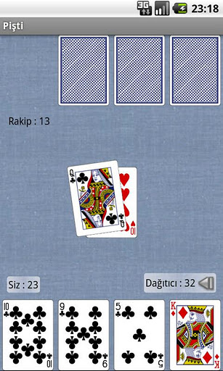
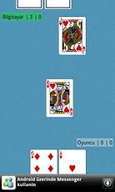
LITERATURE SURVEY
Some examples from Android Market

Slide 7
LITERATURE SURVEY
How does our project differ from others for Android?
Problem of state-of-art systems
Do not exist for online gaming
There is no Blöflü Pişti mode
AI bot can learn

Slide 8
OUR SOLUTION
System Features
Server (PHP)
Database (MySQL)
Android Client
AI bot
Communication Protocol (HTTP)
No peer-peer connection

Slide 9
OUR SOLUTION
Technology and Tools
PHP MyAdmin
Android SDK
Eclipse IDE
DroidDraw User Interface Designer
MySQL Query Browser

Slide 10

GENERAL ARCHITECTURE
Server
Client
Database
Client
AI Bot
Database

Slide 11
WHAT WE HAVE DONE SO FAR?
System Architectural Design
Server Implementation
Database Design
User Interfaces

Slide 12
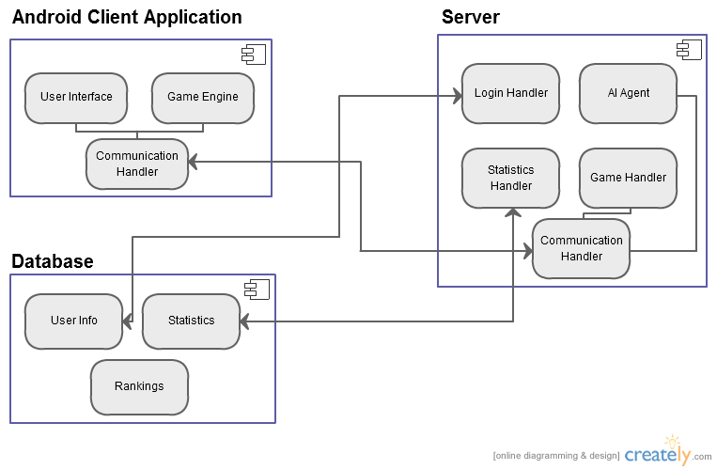
System Architectural Design

Slide 13
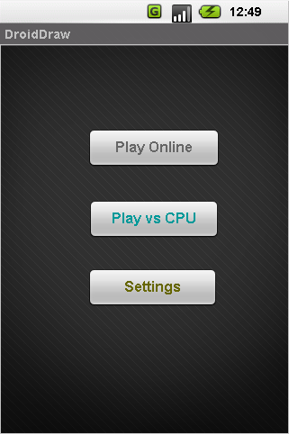
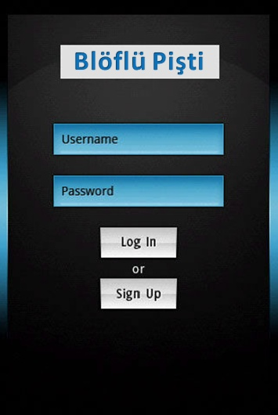
User Interfaces

Slide 14
FUTURE PLAN
Android Client Application
Server Implementation
AI bot Implementation
GUI Improvement
Testing

Slide 15
ANY QUESTIONS ?

