Slide 1

Digitalizing and Vocalizing Sheet Music for Mobile Devices running on Android OS by GOBİT
DigiMuse

Slide 2
Gobit
Ezgi Berberoğlu
M. Burhan Şentürk
M. Yiğit Yıldırım
Kamila Kuchalieva

Slide 3
OUTLINE
Problem Definition
Motivation & Purpose
Literature & Market Survey
Technologies, Methods & Tools;
System Design and Architecture
Challenges and Limitations
What We Have Done So Far ?
Future Work

Slide 4

Problem Definition

Slide 5
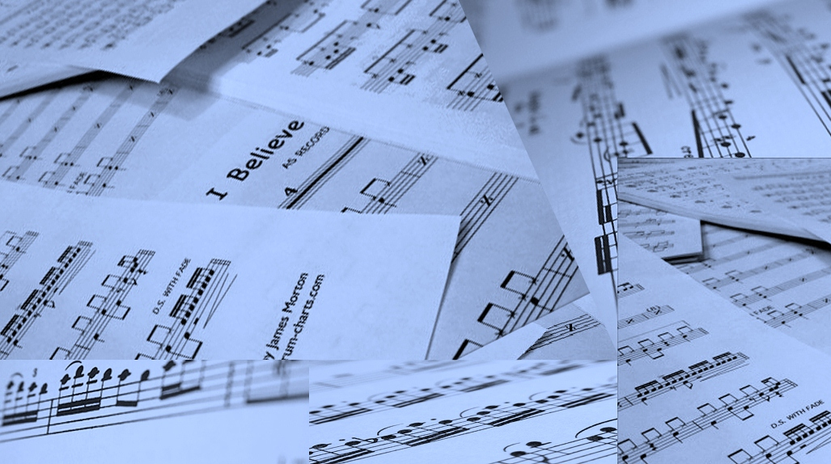
Drawbacks of Maintainance

Slide 6
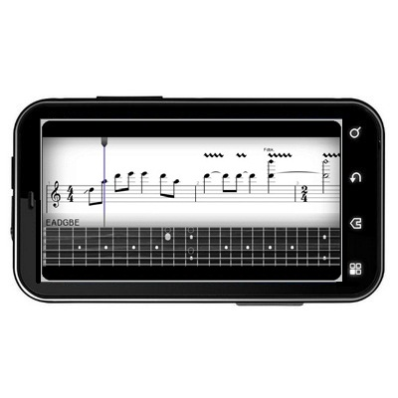
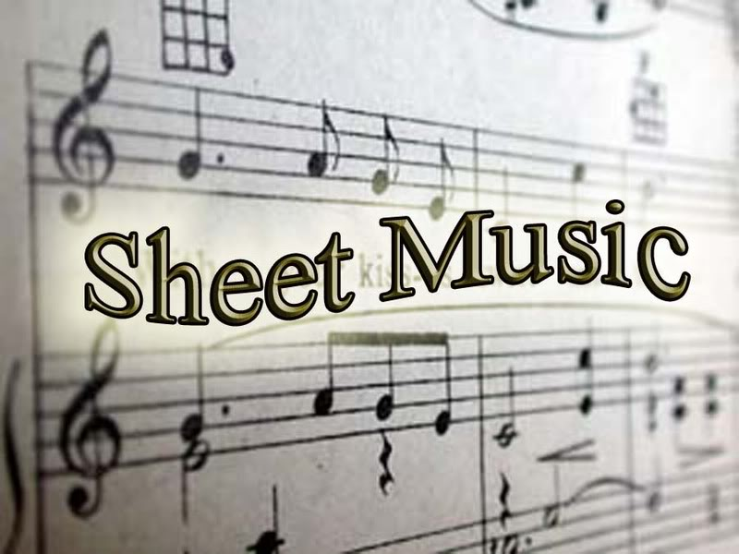
Play it (correctly)!

Slide 7
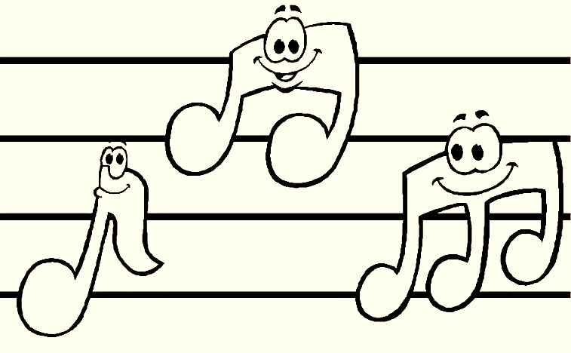
Edit Sheet Music!

Slide 8
Motiviation & Purpose
Personal Need
    Inputing the notes into computer one note at a time.
Digitalizing Sheet Music
    Digitalized vs tones of papers
    Distribution & Portability
Self Educated Musicians
    Poor note reading skills

Slide 9
Literature & Market Survey
Music OCR programs
    SmartScore, Capella-Scan and SharpEye.
    Not practical, need a scanner
    No mobile application
MIDI formatted files
    Most common format of its own type
    Extensively used in the market (easy to find & donwload)

Slide 10
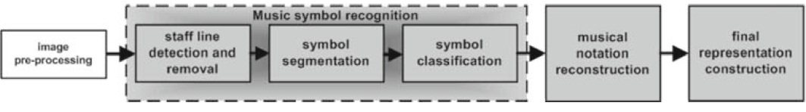
Continued
Literature & Market Survey
What is OMR & how it works?
    Optical Recognition of music symbols”, published by A. Rebelo, G. Capela, and Jaime S. Cardoso
Staff Detection & Removal
Symbol Segmentation
Symbol Classification

Slide 11
Continued
Literature & Market Survey
Methods for Classification & Performances
    Hidden Markov models
    K-nearest neighbor
    Neural Networks
    Support vector machines

Slide 12
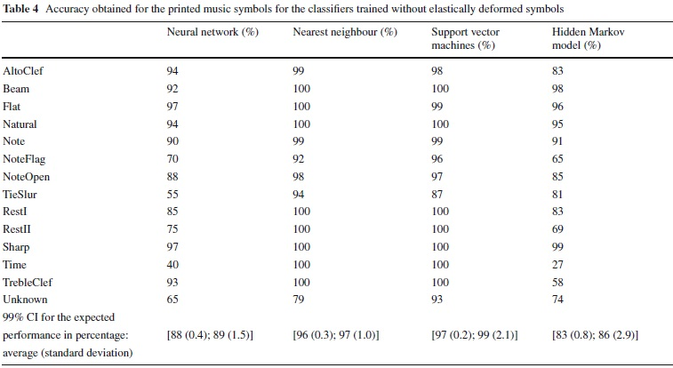

Slide 13
Continued
Literature & Market Survey
Potential Users
  Musicians
      Professionals as well as self-educated
  Publishers & Librarians

Slide 14
Technologies, Methods & Tools
Java
    Android apps are written in the Java(TM) language, and compiled by the JDK's javac compiler.
Android SDK
    DigiMuse will run on mobile devices that suppport Android OS.
Open CV Library
    Image processing functionality
    Problems & Solutions
Eclipse

Slide 16
System Design and Architecture
Optical Music Recognition
Player
Note Editor

Slide 17
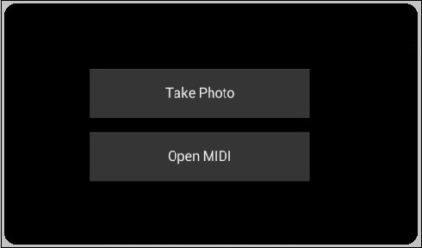
Entrance Screen

Slide 18
OMR (Optical Music Recognition)
Line Detection
Character Detection
Character Classification
Construction of the Data Structure

Slide 19
Data Model
Player
Sheet
Bar
Note

Slide 20
Player Module
Play / Pause / Stop
Basic Alterations on Sheet
Customization

Slide 21
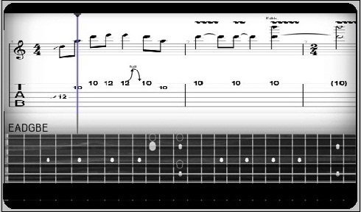
Player

Slide 22
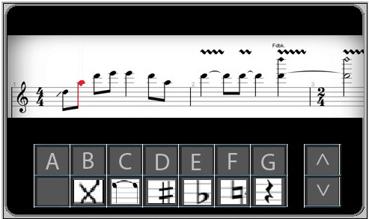
Edit Mode

Slide 23

OMR
User takes a photo.
User
User opens a
MIDI file
Player Module
Exit
Note Editor Module

Slide 24
Challenges and Limitations
Limited CPU Power
Limited Memory
  - Max. Heap Size for an Android App. Is 16 MB.
Lack of Available Libraries and Samples

Slide 25
What We Have Done So Far ?
Manipulation of MIDI Files
GUI Design in XML Format
Image Down-Sampling
Image Deskewing
Detection of Line Positions

Slide 26
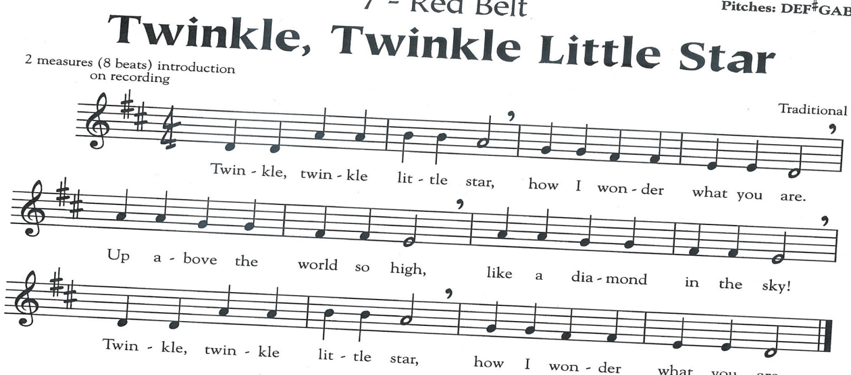
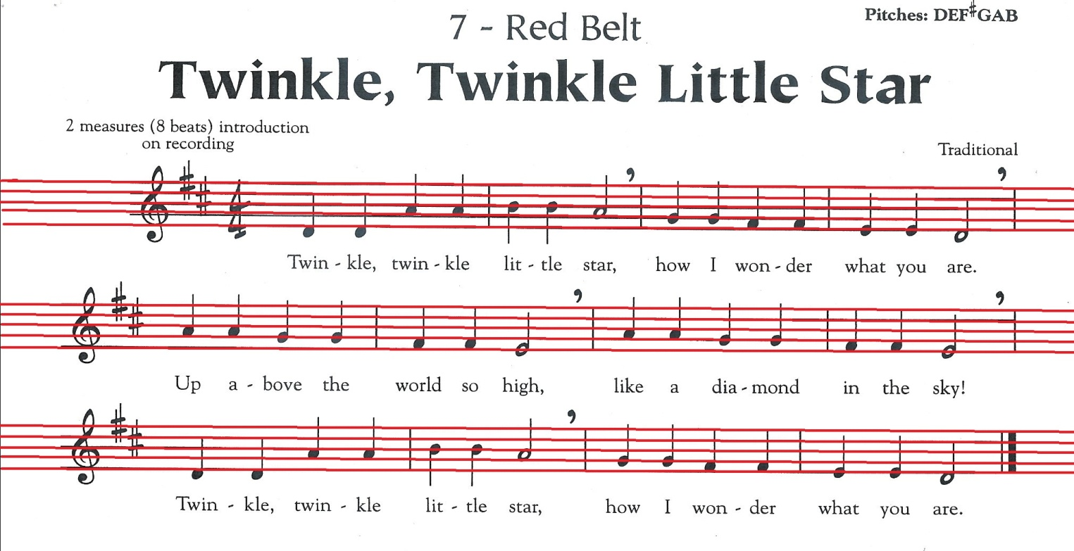

Slide 27
Future Work
GUI Implementation
Note Detection
Integration of Modules

Slide 28
References
    Optical Recognition of music symbols”, published by A. Rebelo, G. Capela, and Jaime S. Cardoso
http://jindroid.com/2010/10/11/max-heap-size-for-an-android-application/
http://www.lib.virginia.edu/artsandmedia/dmmc/Music/UnicodeMusic/
http://opencv.willowgarage.com/wiki/
http://developer.android.com/sdk/ndk/overview.html
http://developer.android.com/guide/developing/tools/index.html
http://www.dsi.unifi.it/~hpcn/wwwomr/le.html

Slide 29
Thanks for Listening
Questions ?

