Slide 1
Alternative & Augmentative Communication for Android OS
By

Slide 2
Coşkun ŞAHİN
Gökhan OĞUZ
Evren PALA

Slide 3
OUTLINE
Problem Definition
Motivation
Literature Survey
Our Solution
General Architecture
What We Have Done So Far?
Future Work Plan
Questions

Slide 4
Problem Definition
Speech disability
Drawbacks of sign language
Lack of AAC solutions for Turkish

Slide 5
MOTIVATION
Project benefits to speech-impaired people
Technology for a better life…
Development in Android platform
Becoming more widespread every day…
Providing TTS technology for Turkish
Why do not we have?

Slide 6
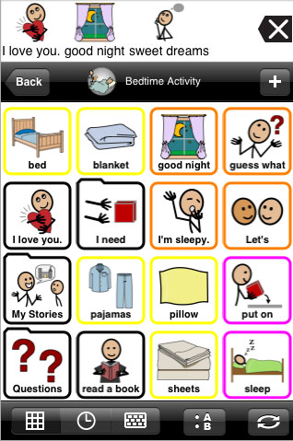
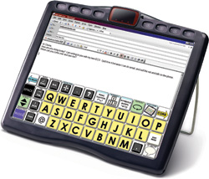
Literature Survey
Latest AAC solutions in the advanced countries
iOS AAC application ECO[2]

Slide 7
Literature Survey
How does AAC-Droid differ from the others?
Problem of state-of-art systems
Do not exist for Turkish language
Problems of Turkish AAC products
Do not exist any solution on Android platform
Can not be called as “state-of-art”
Potential users

Slide 8
OUR SOLUTION
System Features
Designed for Android OS 2.2 or higher versions
Accepts only Turkish language
Provides real time communication
Image-to-speech option with text-to-speech
Extendible image library

Slide 9
OUR SOLUTION
Technology
Java Programming Language
Eclipse Platform
Android SDK
Android Virtual Device Manager
MySQL DBMS
SQLite

Slide 10
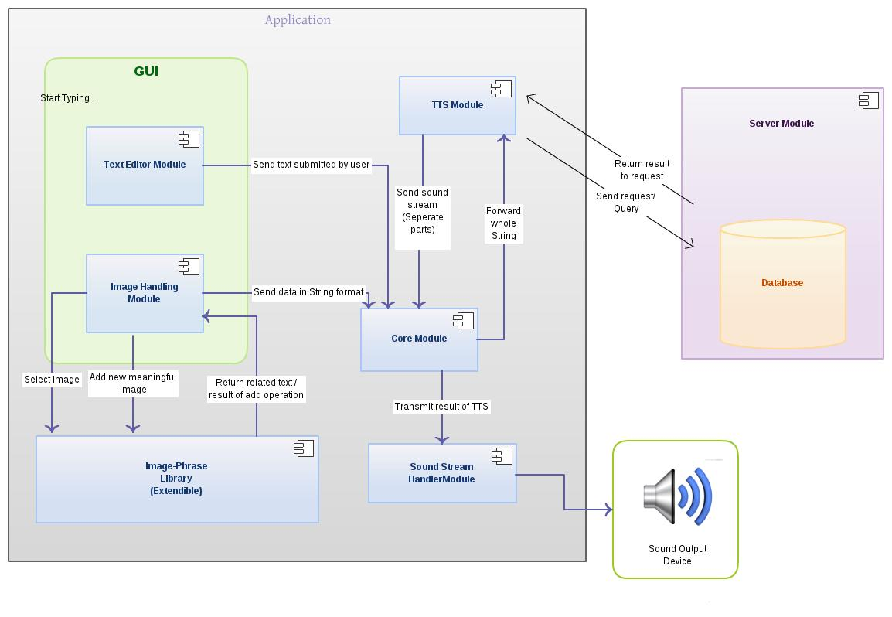
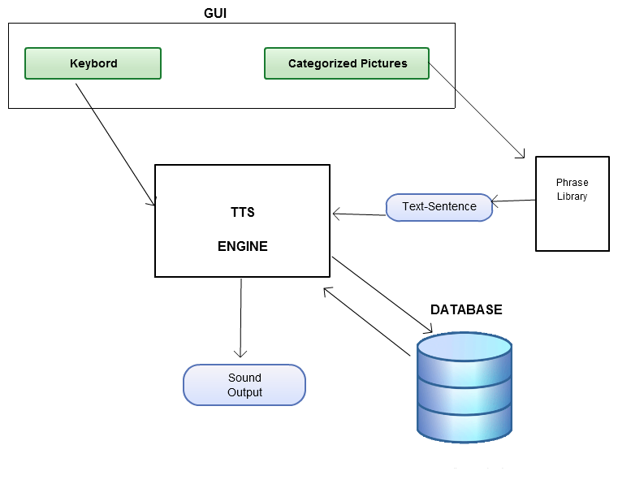
GENERAL ARCHITECTURE

Slide 11
GENERAL ARCHITECTURE
Text-to-Speech
TTS System

Slide 12
What We Have Done So Far?
System Architectural Design
Google TTS API
GUI implementation

Slide 13
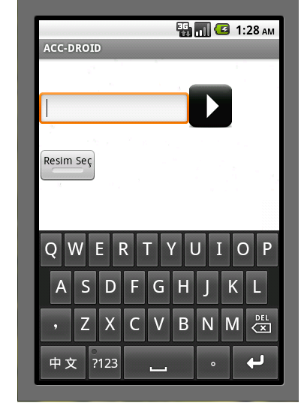
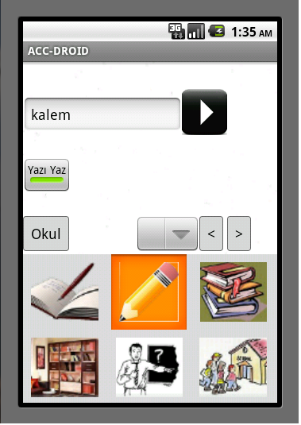
What We Have Done So Far?
Graphical User Interfaces

Slide 14
Future Plan
GUI improvement
TTS implementation
Server implementation
Database design
Testing

Slide 15
ANY QUESTION

