Slide 1
DynaDraw
DRAWING BASED MOBILE GAME

Slide 2
Team Members
Bünyamin Sarıgül
Turan Soyuer
Cemil Kocaman
Barış Özçelik

Slide 3
What is Our Project
Drawing Based
Unity
2D
Multi-Platform

Slide 4
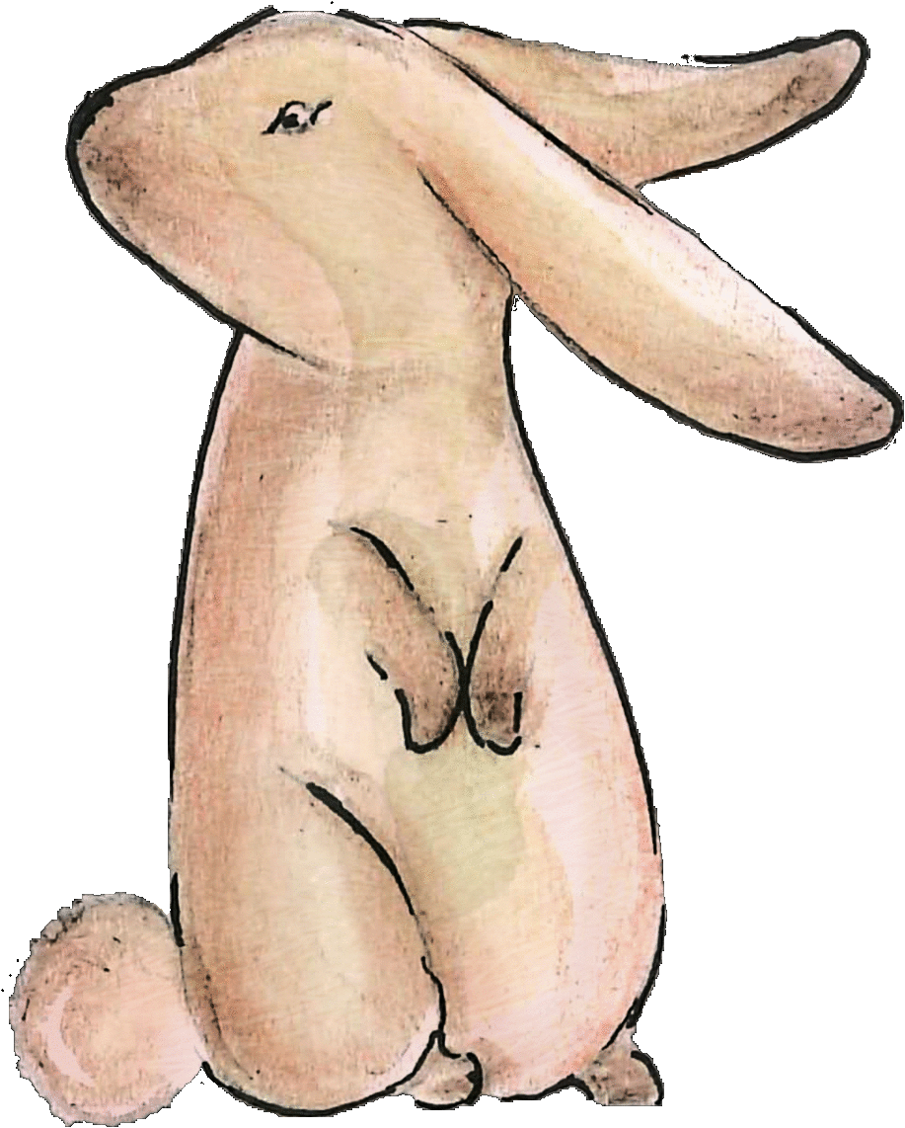
What are Our Differences
For Children
Creative
No Violence

Slide 5
Game
Drawing Scene
Physical Lines
Game Environment
Character Animation

Slide 6
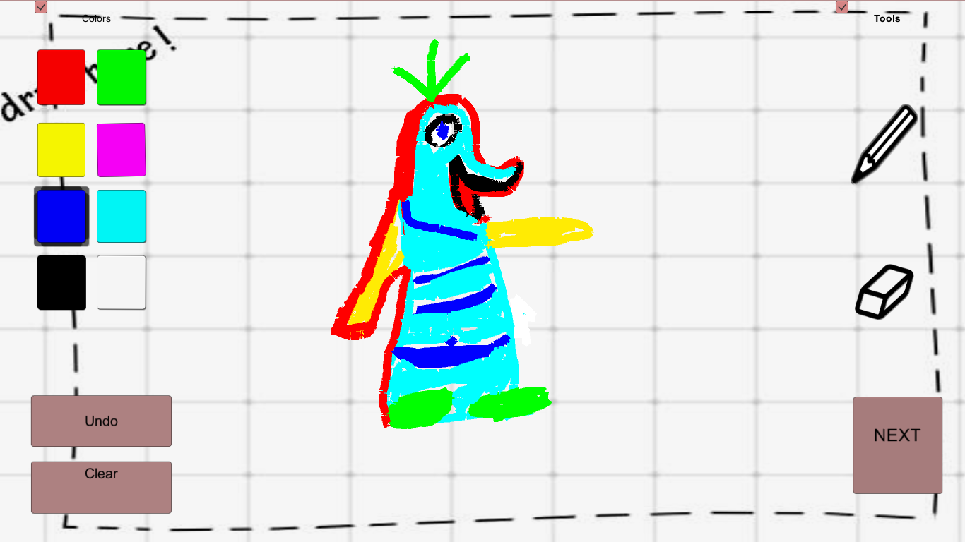
Drawing Scene

Slide 7
Theme

Slide 8
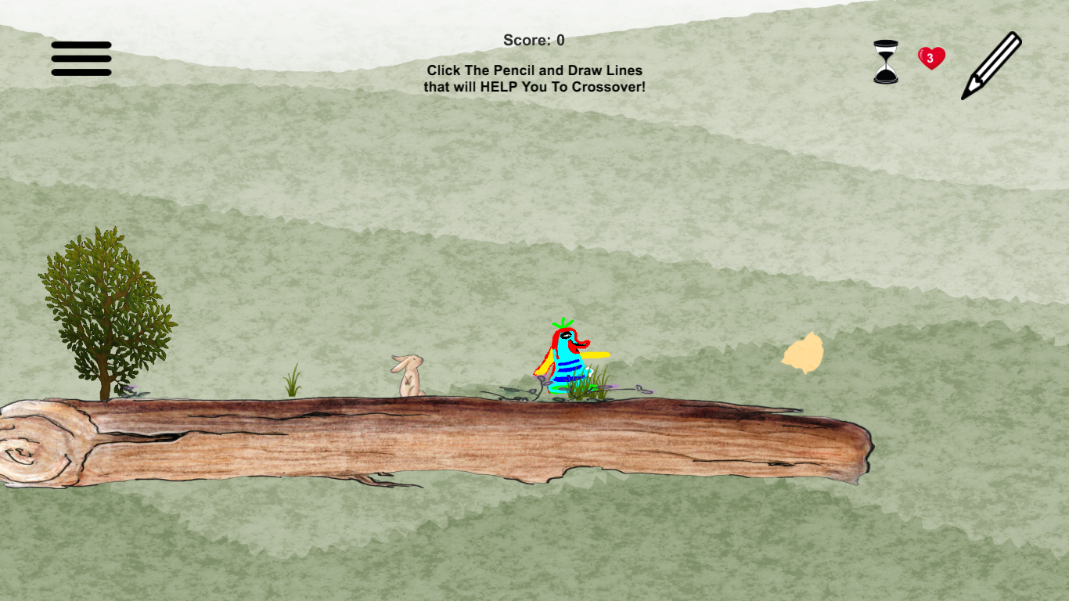
Game Scenes

Slide 9
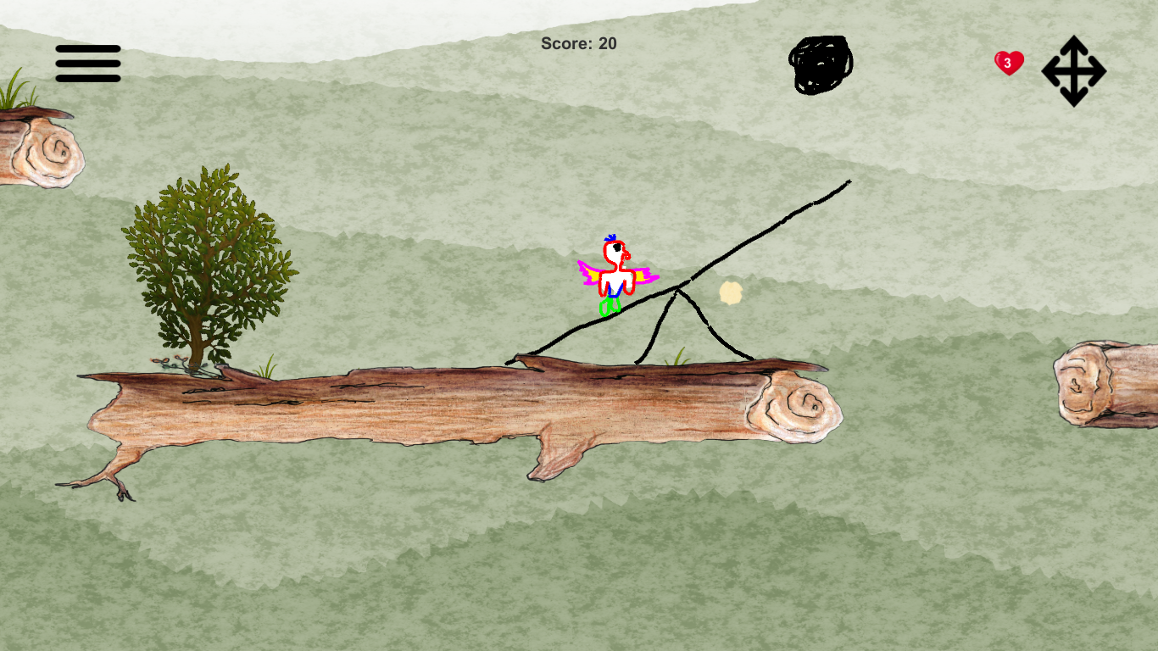
Physical Lines and Other Challenges

Slide 10
Questions

